Slide 1
PART 2 Testing Fundamentals

Slide 2
Agenda

Slide 3
1. Dynamic White-Box Testing
2. Dynamic White-Box Testing Versus Debugging
3. Testing the Pieces
4. Data Coverage
5. Code Coverage

Slide 4
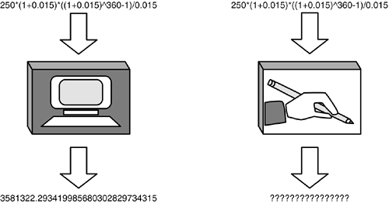
1. Dynamic White-Box Testing

Slide 5
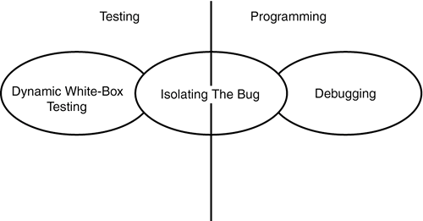
2. Dynamic White-Box Testing Versus Debugging

Slide 6
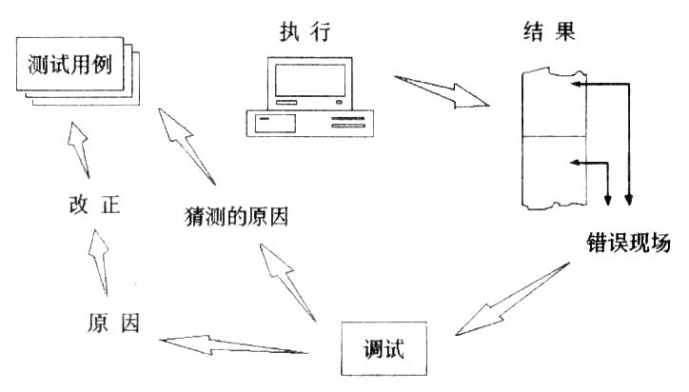
2. Dynamic White-Box Testing Versus Debugging

Slide 7
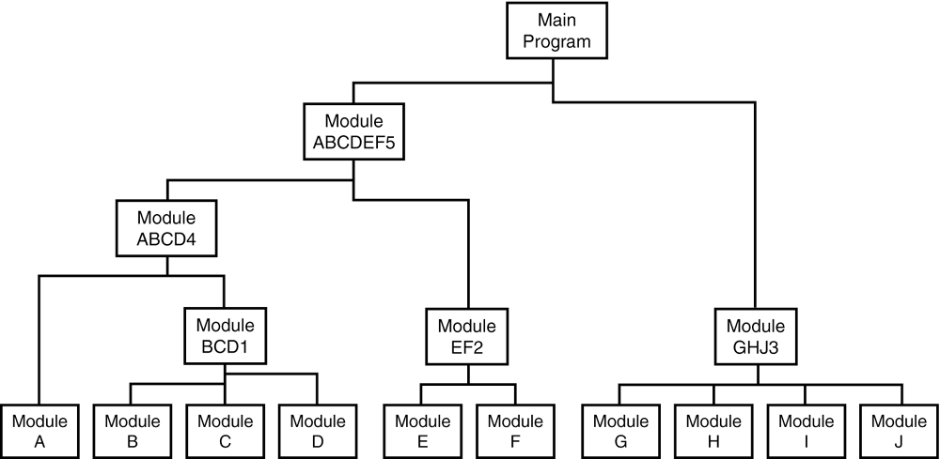
3. Testing the Pieces
1) Unit and Integration Testing

Slide 8
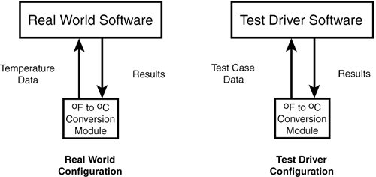
3. Testing the Pieces
1) Unit and Integration Testing

Slide 9
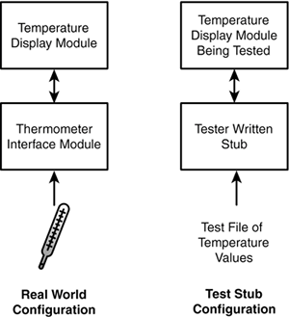
3. Testing the Pieces
1) Unit and Integration Testing

Slide 10
3. Testing the Pieces
2) An Example of Module Testing

Slide 11
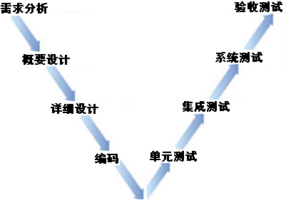
3. Testing the Pieces
3) Testing Process Model (V Model)

Slide 12
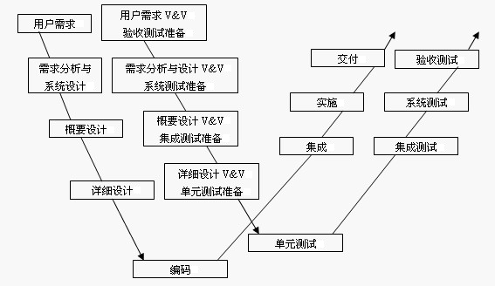
3. Testing the Pieces
3) Testing Process Model (W Model)

Slide 13
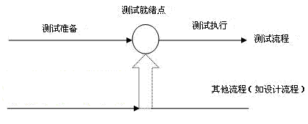
3. Testing the Pieces
3) Testing Process Model (H Model)

Slide 14
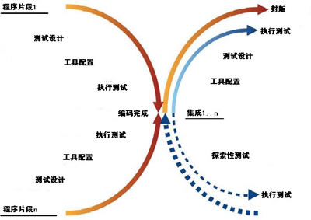
3. Testing the Pieces
3) Testing Process Model (X Model)

Slide 15
4. Data Coverage
  Data Flow
  Sub-Boundaries
  Error Forcing

Slide 16
5. Code Coverage
  Program Statement and Line Coverage
  Branch Coverage
  Condition Coverage

Slide 17


入口
Y
(A>1)&&(B==0)
X=X/A
N
Y
(A==2)||(X>1)
X=X+1
N
结束

Slide 18
1. Dynamic White-Box Testing
2. Dynamic White-Box Testing Versus Debugging
3. Testing the Pieces
4. Data Coverage
5. Code Coverage

Slide 19
TASK:
1. Test and debug WordCNT App.
1). Unit testing
2). Debugging

